Slide 2
Pipelines
10-6 P1: …
10-6 P2: …
12-14 P1: …
12-14 P2: …
12-18 P3: …

Slide 3
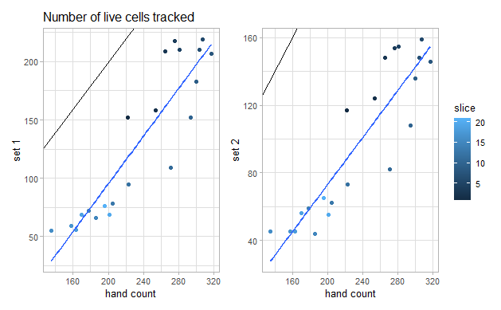
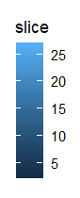
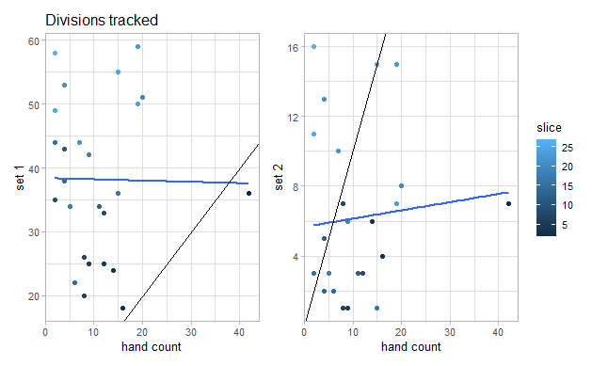
E2_1_T=50_App=1001_Disapp=1.5 10-6
Live Cells
Dividing Cells
pearson correlation coefficient (r = 0.90516 )
mean absolute error
(MAE = 104)
pearson correlation coefficient (r = -0.01414354 )
mean absolute error
(MAE = 28.19231)

Slide 4
E2_1_T=50_App=1001_Disapp=1001 10-6
Live Cells
Dividing Cells
pearson correlation coefficient (r = 0.8980128)
mean absolute error
(MAE = 137.1429)
pearson correlation coefficient (r = 0.08850193)
mean absolute error
(MAE = 7.269231)

Slide 5
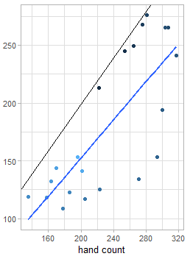
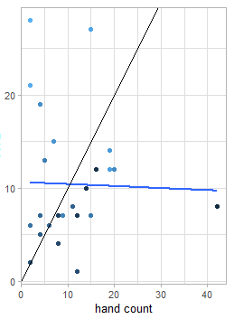
P1 12-14
Live Cells
Dividing Cells
pearson correlation coefficient (r = 0.7601517)
mean absolute error
(MAE = 53.42857)
pearson correlation coefficient (r = -0.05475514)
mean absolute error
(MAE = 7.730769)

Slide 6
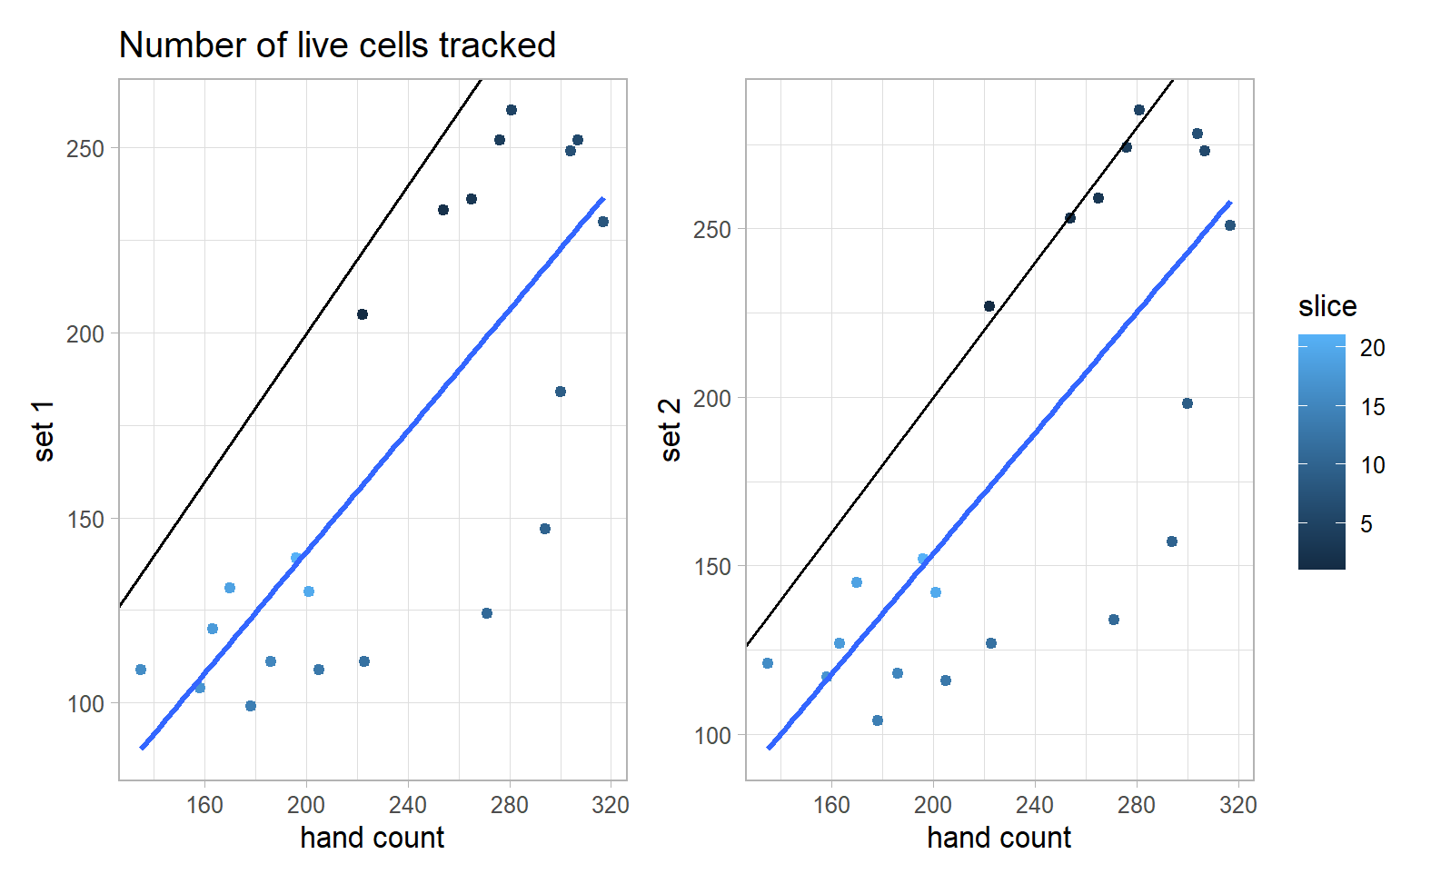
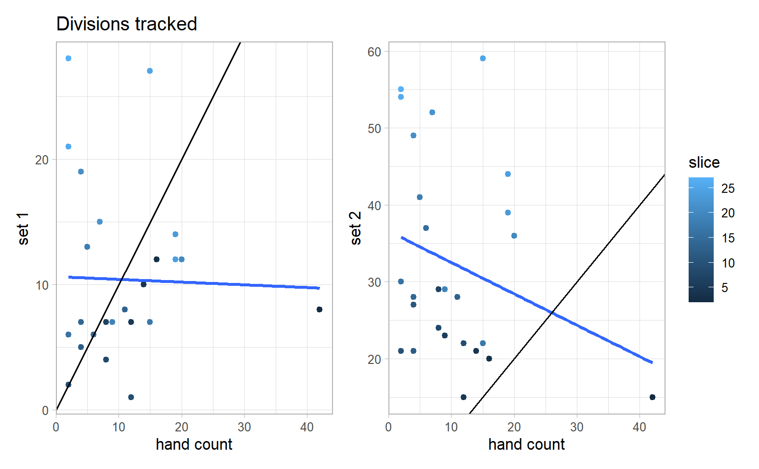
P2 12-14
Live Cells
Dividing Cells
pearson correlation coefficient (r = 0.7705258)
mean absolute error
(MAE = 65.28571)
pearson correlation coefficient (r = -0.0270048)
mean absolute error
(MAE = 7.5)

Slide 7
P3 12-18
Live Cells
Dividing Cells
pearson correlation coefficient (r = 0.7625212)
mean absolute error
(MAE = 50.7619)
pearson correlation coefficient (r = -0.268958)
mean absolute error
(MAE = 24)

